Slide 1
Proper Show Pig Care
By Jacob Rauker

Slide 2
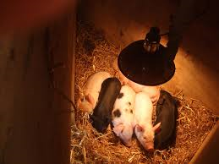
Pigs Arrive
Its important that when you first get your pigs when they are still piglets that you have them under a heat lamp with fresh bedding and easy access to food and water.

Slide 3
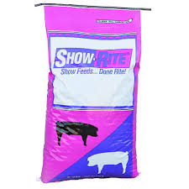
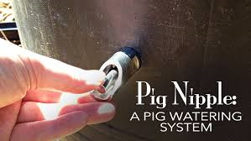
Feed and Water
When the pigs are little piglets they should be fed
About one-half of a regular sized coffee can. And should always have the maximum amount of water.
Once they get bigger you can feed them anywhere from one-half to a full coffee can. Its important to feed them highly nutritious feeds and maintain their diet.

Slide 4
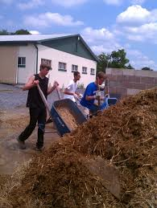
Cleaning Your Pigs
Its important to clean your pigs to prevent spread of disease and remove bacteria to protect your pig from illnesses. Make sure you clean them 1or more times a day. A cleaner pig is always a better pig.

Slide 5
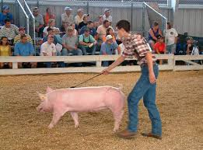
Walking your pigs
Once you’ve had your pigs for 2 weeks, you can begin walking them. Start them at about 10-15 minute's and gradually make it longer as you approach the fair.

Slide 6
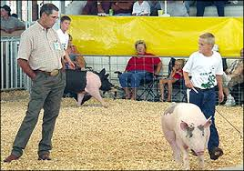
Fair Time
Once the fair comes your going to have to transport your pig. Keep it cool and relaxed. At the fair use all the teqniques you’ve seen, put them all together and put on a show. As long as your dedicated you will be succesful!

